Slide 1
Garbage Collection in Java
Kaustubh Kulkarni

Slide 2
Tuning memory performance
There are three components of the JVM that are focused on when tuning performance.
The heap is where your object data is stored.
This area is then managed by the garbage collector selected at startup.
Most tuning options relate to sizing the heap and choosing the most appropriate garbage collector for your situation.
The JIT compiler also has a big impact on performance but rarely requires tuning with the newer versions of the JVM.

Slide 3
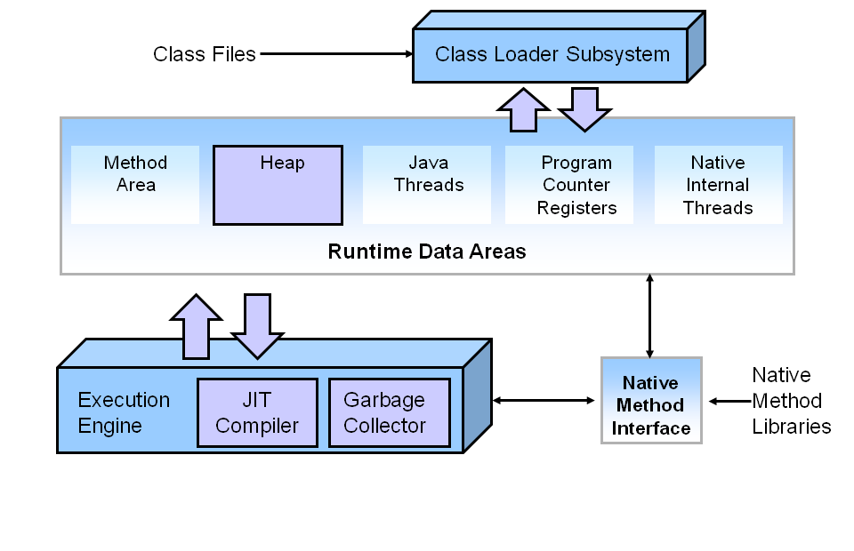
Tuning memory performance

Slide 4
Performance Basics
Typically, when tuning a Java application, the focus is on one of two main goals: responsiveness or throughput.
Responsiveness refers to how quickly an application or system responds with a requested piece of data.
Examples include:
How quickly a desktop UI responds to an event
How fast a website returns a page
How fast a database query is returned
For applications that focus on responsiveness, large pause times are not acceptable.
The focus is on responding in short periods of time.

Slide 5
Performance Basics
Throughput focuses on maximizing the amount of work by an application in a specific period of time.
Examples of how throughput might be measured include:
The number of transactions completed in a given time.
The number of jobs that a batch program can complete in an hour.
The number of database queries that can be completed in an hour.

Slide 6
What is Automatic Garbage Collection?
Automatic garbage collection is the process of looking at heap memory, identifying which objects are in use and which are not, and deleting the unused objects.
An in use / alive object, or a referenced object, means that some part of your program still maintains a pointer to that object.
An unused object, or unreferenced object, is no longer referenced by any part of your program.
So, the memory used by an unreferenced object can be reclaimed.
In a programming language like C, allocating and deallocating memory is a manual process.
In Java, process of deallocating memory is handled automatically by the garbage collector.

Slide 7
Step 1: Marking
This is where the garbage collector identifies which pieces of memory are in use and which are not.
All objects are scanned in the marking phase to make this determination.
This can be a very time-consuming process if all objects in a system must be scanned.

Slide 8
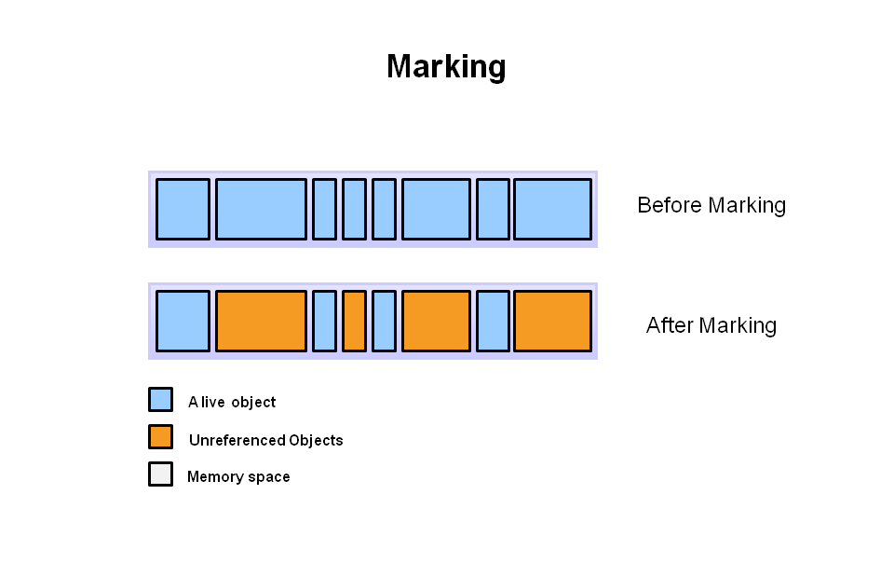

Slide 9
Step 2: Normal Deletion
Normal deletion removes unreferenced objects leaving referenced objects and pointers to free space.
The memory allocator holds references to blocks of free space where new object can be allocated.

Slide 10
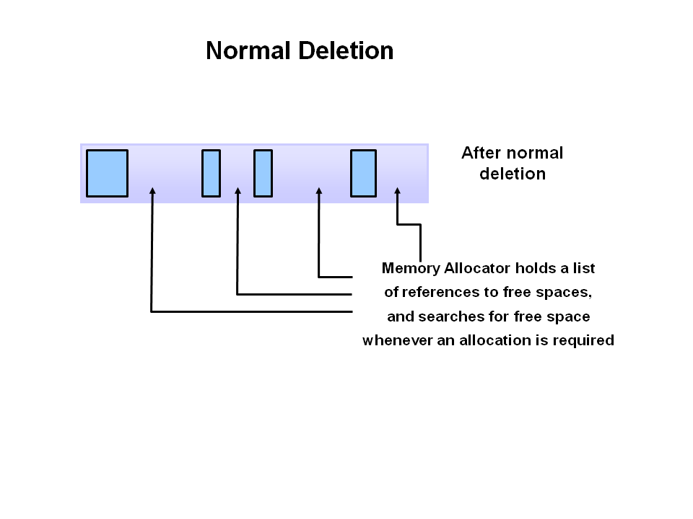

Slide 11
Step 2a: Deletion with Compacting
To further improve performance, in addition to deleting unreferenced objects, you can also compact the remaining referenced objects.
By moving referenced object together, this makes new memory allocation much easier and faster.

Slide 12
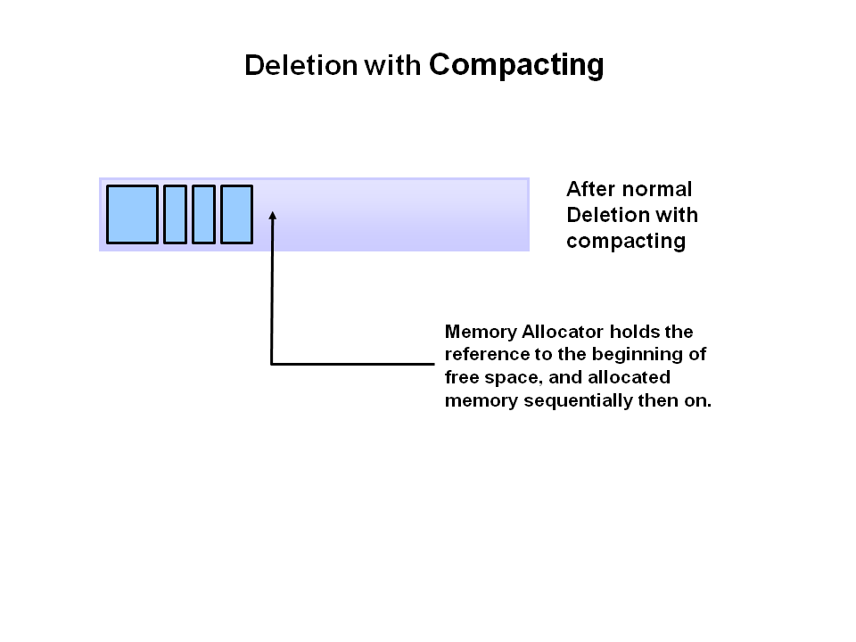

Slide 13
Why Generational Garbage Collection?
Having to mark and compact all the objects in a JVM is inefficient.
As more and more objects are allocated, the list of objects grows and grows leading to longer and longer garbage collection time.
However, empirical analysis of applications has shown that most objects are short lived.

Slide 14
JVM Generations
The information learned from the object allocation behavior can be used to enhance the performance of the JVM.
Therefore, the heap is broken up into smaller parts or generations.
The heap parts are: Young Generation, Old or Tenured Generation, and Permanent Generation

Slide 15
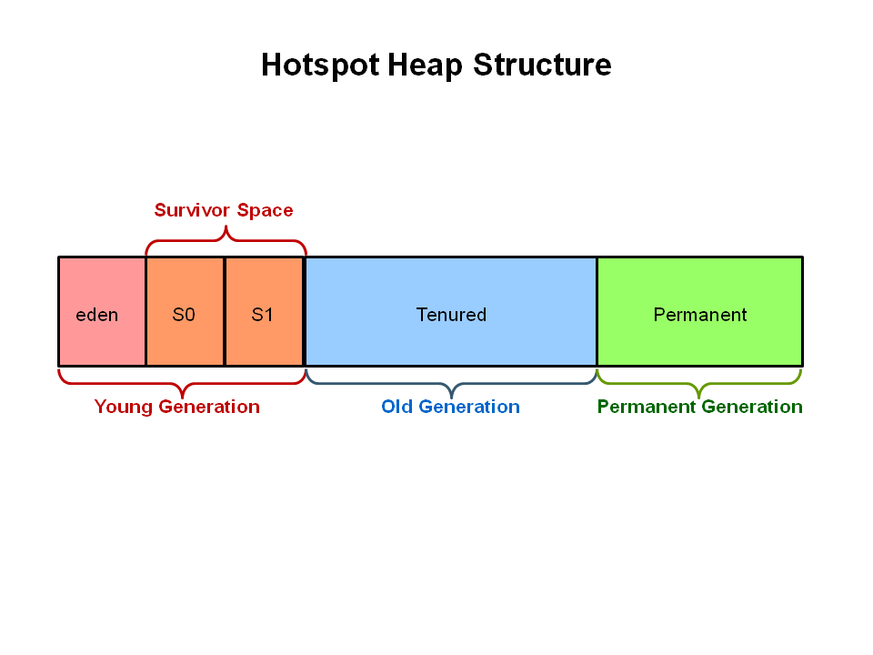

Slide 16
Young Generation
The Young Generation is where all new objects are allocated and aged.
When the young generation fills up, this causes a minor garbage collection.
Minor garbage collections can be optimized assuming a high object mortality rate - a young generation full of dead objects is collected very quickly.
Some surviving objects are aged and eventually move to the old generation.
Stop the World Event - All minor garbage collections are "Stop the World" events.
This means that all application threads are stopped until the operation completes.
Minor garbage collections are always Stop the World events.

Slide 17
Old Generation
The Old Generation is used to store long surviving objects.
Typically, a threshold is set for young generation object and when that age is met, the object gets moved to the old generation.
Eventually the old generation needs to be collected.
This event is called a major garbage collection.
Major garbage collection are also Stop the World events.
Often a major collection is much slower because it involves all live objects.
So, for Responsive applications, major garbage collections should be minimized.
Also note, that the length of the Stop the World event for a major garbage collection is affected by the kind of garbage collector that is used for the old generation space.

Slide 18
The Generational Garbage Collection Process
First, any new objects are allocated to the eden space.
Both survivor spaces start out empty.

Slide 19
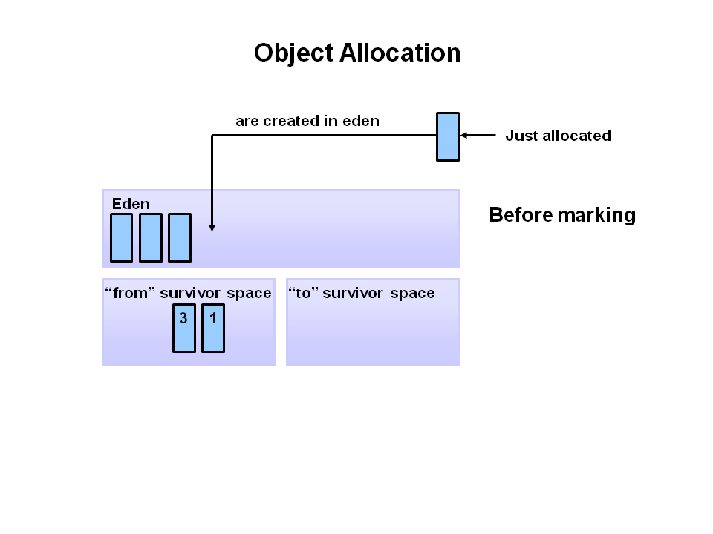

Slide 20
When the eden space fills up, a minor garbage collection is triggered.

Slide 21
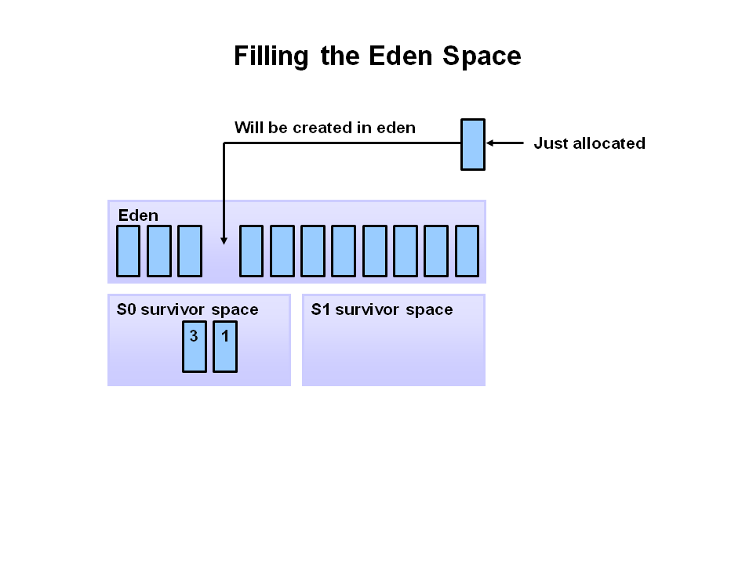

Slide 22
Referenced objects are moved to the first survivor space.
Unreferenced objects are deleted when the eden space is cleared.

Slide 23
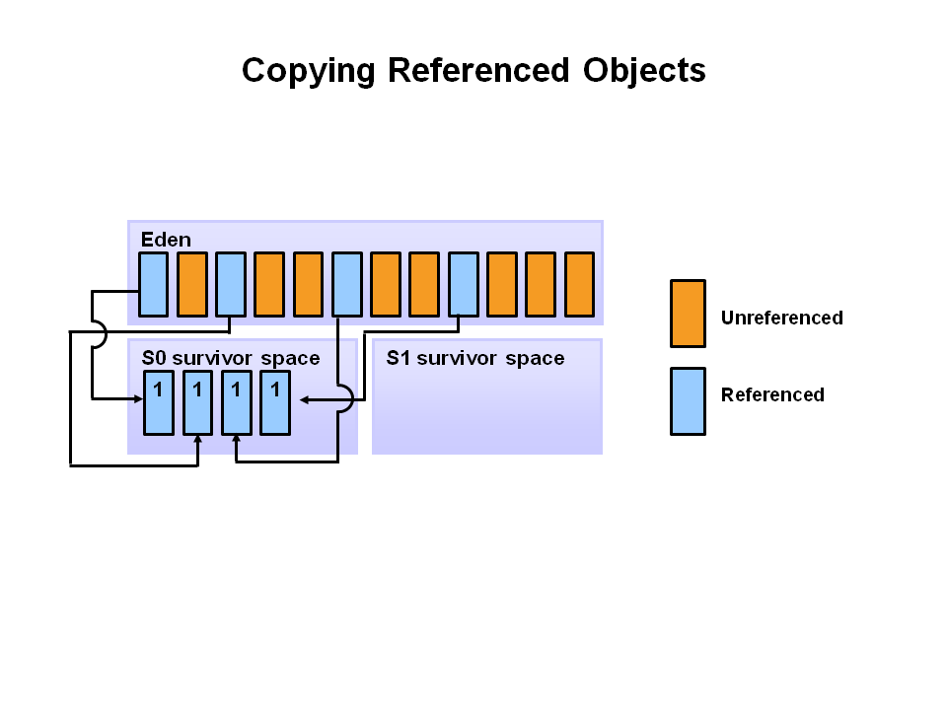

Slide 24
At the next minor GC, the same thing happens for the eden space.
Unreferenced objects are deleted and referenced objects are moved to a survivor space.
However, in this case, they are moved to the second survivor space (S1).
In addition, objects from the last minor GC on the first survivor space (S0) have their age incremented and get moved to S1.
Once all surviving objects have been moved to S1, both S0 and eden are cleared.
Notice we now have differently aged object in the survivor space.

Slide 25
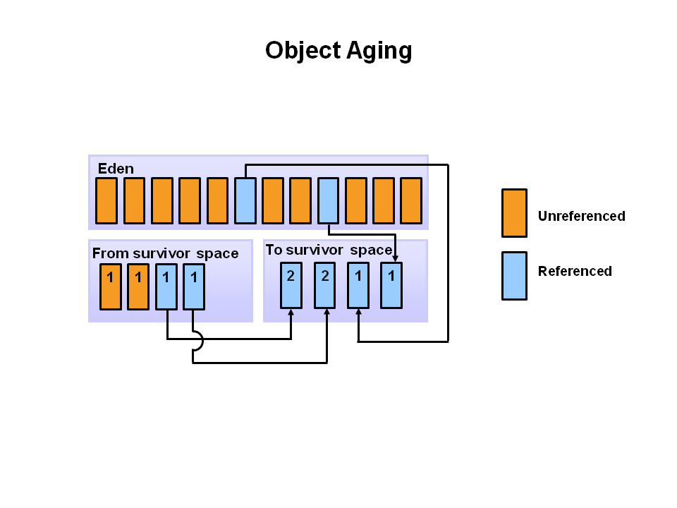

Slide 26
At the next minor GC, the same process repeats.
However, this time the survivor spaces switch.
Referenced objects are moved to S0.
Surviving objects are aged. Eden and S1 are cleared.

Slide 27
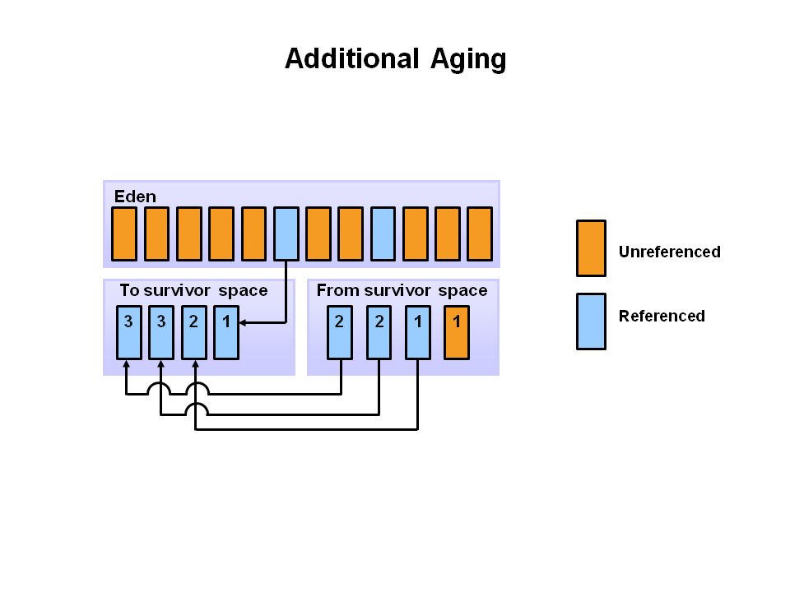

Slide 28
This slide demonstrates promotion.
After a minor GC, when aged objects reach a certain age threshold (8 in this example) they are promoted from young generation to old generation.

Slide 29
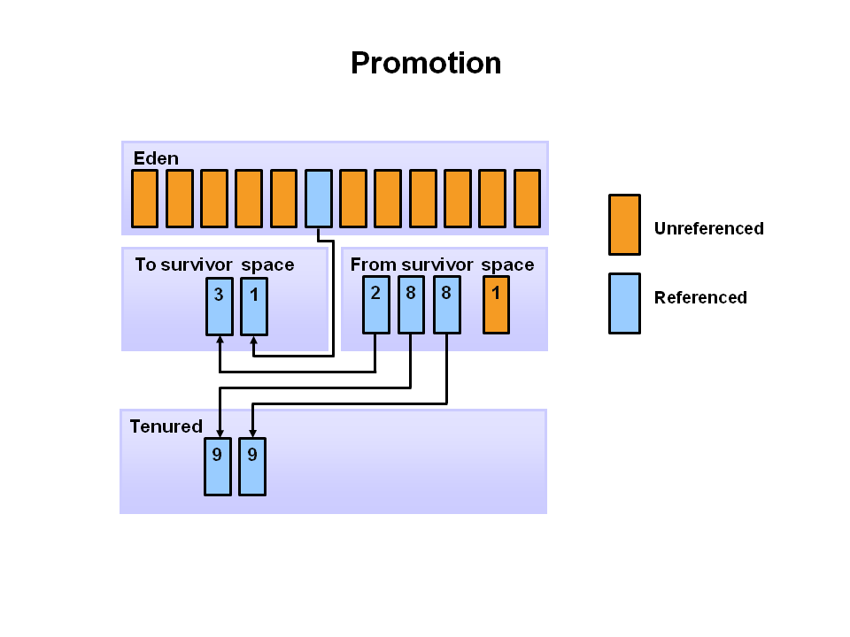

Slide 30
As minor GCs continue to occur objects will continue to be promoted to the old generation space.
So that pretty much covers the entire process with the young generation.
Eventually, a major GC will be performed on the old generation which cleans up and compacts that space.

Slide 31
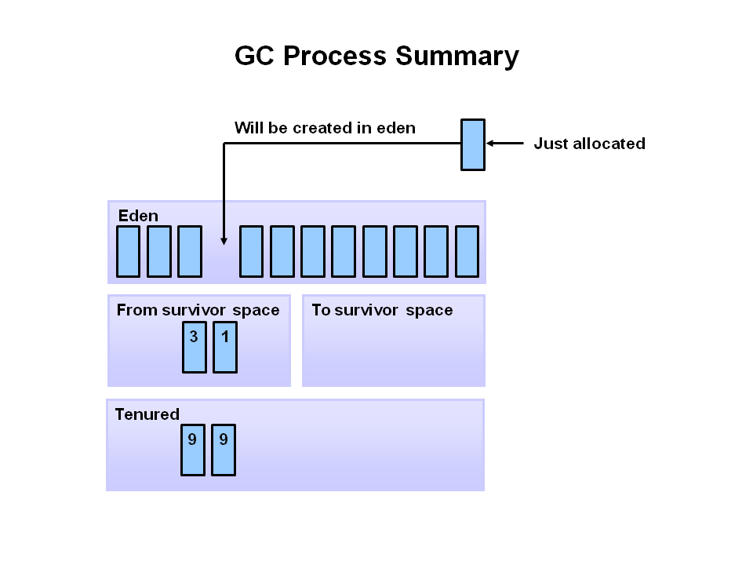

Slide 32
Questions ?

